Slide 1
Design Thinking
Warm Up Question: What are your favorite Applications? Do they rely on servers or the internet? Do they make assumptions about their audience? (snapchat for example)

Slide 2

Design Thinking

Slide 3
Design Thinking
Observe
Emphasize with your audience
Gather ideas
Ideation
Assemble ideas into requirements
Prototype
Write some code
Test
Test the code you write, both internal and external
Repeat

Slide 4
Coding Practice – Loops and Strings

Slide 5
Let’s Practice
Individually
Write a method on paper
returns a String
takes in three parameters, String str, and int start and int end
In the method,
write a loop that goes from start and < end
it grabs the charAt that index, and adds it to a string (hint, start with an empty string)
returns the new string you built!
After five minutes, we will have you pair up, and work together on the method
Question
What method did you just build?
Does it seem familiar?
Overload the method
takes in two parameters, String str, and int start
Assumes end is the str.length()

Slide 6
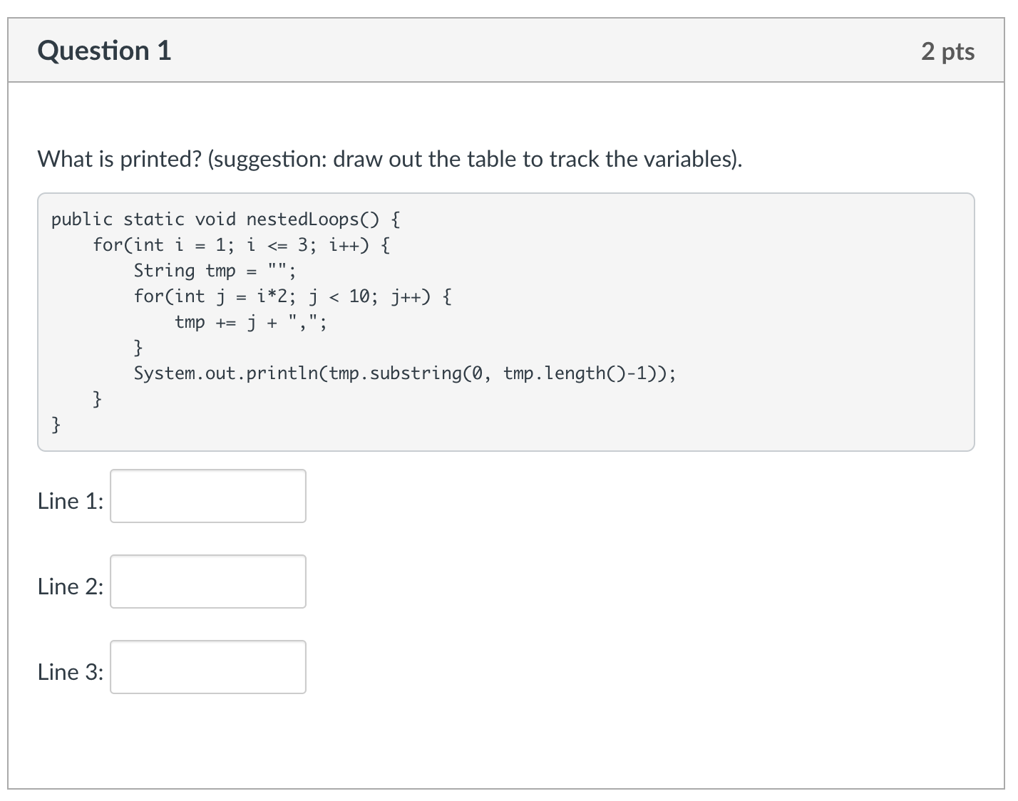
Knowledge Check

Slide 7
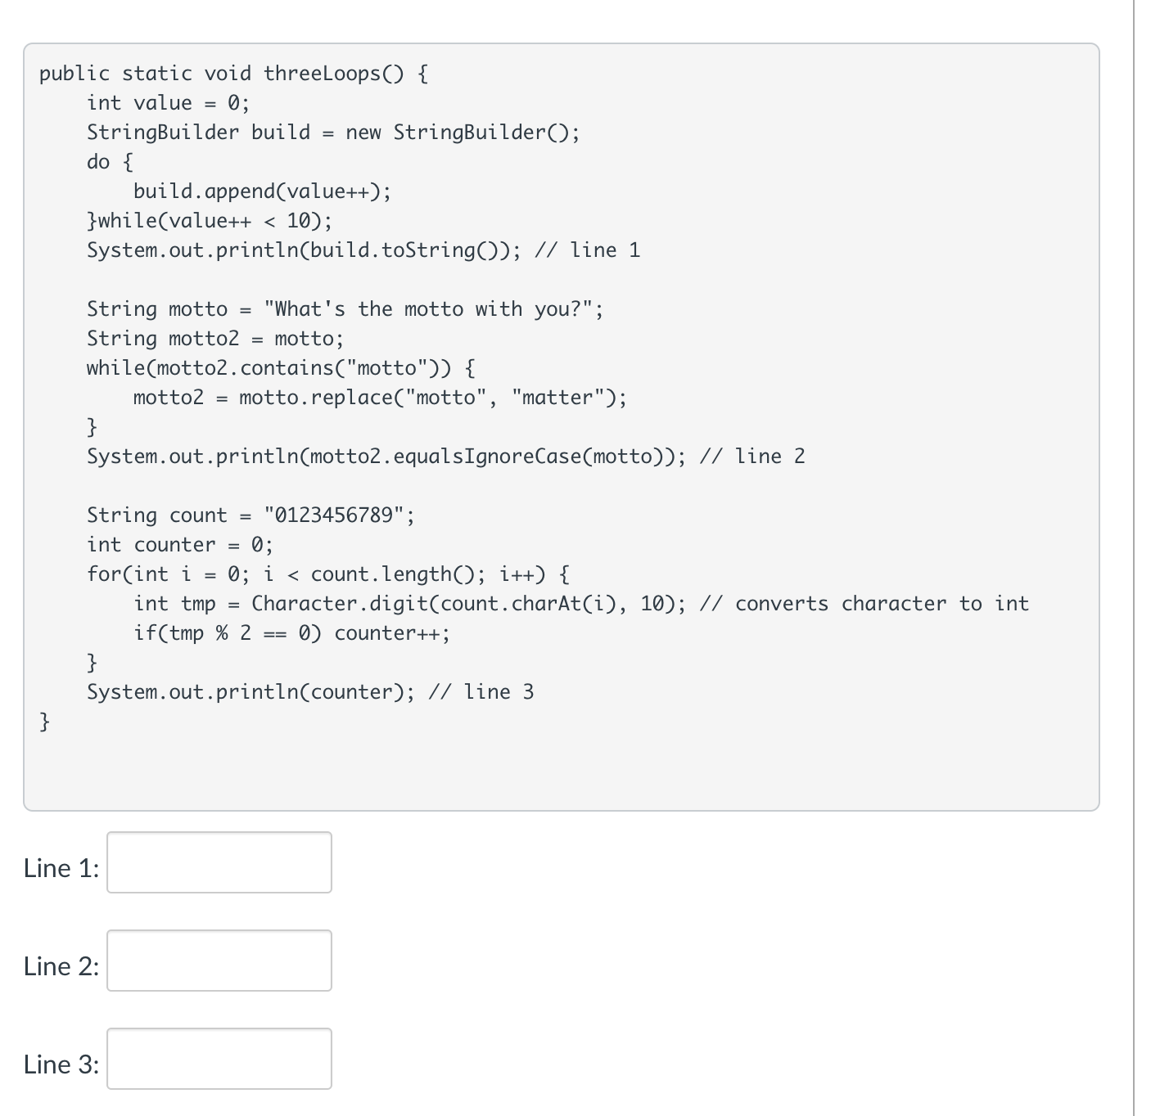
Knowledge Check
A lot is going on in this one!
Talk it through with others
The TA will guide you!
essentially 3 questions in one

